Slide 1
DREAM BIG – by Team M.I.M
Aim : The major problem hindering the development of our country is unwanted production of engineers and doctors against their whim .We believe that every child is equal in terms of intelligence ,it's the level of motivation and idea of 'why they are doing it’, which differentiates them .And every child have a dream or something they are interested in but in India parents are forcing them to a particular career just to be safe .So basically they will just survive in the field and doesn't grow .That interest of a child might be the pushing factor which makes them wake up early in the morning and to increase their thirst for knowledge . So our idea is to make students, moreover their parents understand the different job opportunities available and how they are as safe as or more safe to engineering and all .Not only the jobs but also the necessary skills they need to develop at a very early stage (4th or 5th grade)
about

Slide 2
So our idea is to make students, moreover their parents understand the different job opportunities available and how they are as safe as or more safe to engineering and all .Not only the jobs but also the necessary skills they need to develop at a very early stage (4th or 5th grade)
…

Slide 3
GOAL
our goal is to help students understand the need for passion in the earliest stage possible.
Their passion might be the only thing which pushes their limits each day.
Once they found their passion many students struggle to develop the necessary skills due to lack of unawareness.
So we help them to find their passion and skills at the right time.
goal

Slide 4
CHALLENGES
The challenges faced are uncountable but the most severe one would be parents
Parents want to make their kids safe so they push them into generic fields such as engineer ,doctor ,manger etc..
India this pressure is over the top,that must be why 33% of engineers are jobless or made their career in a different field.
challenges

Slide 5
TACKLING
We make parents understand the scope of the field their children aspire to be
They will eventually understand the status and salary of these jobs are comparable or even better than what they hoped
This way many unexplored jobs could be utilized which inturn helps in development of our country
tackle

Slide 6
STATUS BARRIER
The status barrier in jobs is one fo the main reasons why entrance coaching is flourishing in India.
Engineers and doctors are considered to be of higher status.
We help to make our citizens aware that a simple carpenter can be as valuable as an engineer and can make a significant change in the society by providing examples of successful personalities and a roadmap.
status

Slide 7
Why does normal state school children become less successful?
We believe that every child has same intelligence in all fields.
What differs them is the motivation towards a particular field
Normal state school children grows up seeing their parents who might have hard labour jobs.Therefore their sole intention becomes to provide their family,this leads to them stoping education and following their parents path
Moreover the parents are unaware of all oppurtunities their kids have
school

Slide 8
While students generally in private ,aided schools might have parents working in white collar jobs.
So they automatically indulge in education much more
They most probably don’t follow their passion but chooses a better career option
Here ,their parents give them the push they needed
…

Slide 9
What we do-
we help them to find their passion and skills at the right time ,more importantly to develop the skills required for their career.(like public speaking at very early stage could eliminate the embarrassment later on)
We help to make our citizens aware that a simple carpenter can be as valuable as an engineer and can make a significant change in the society by providing examples of successful personalities and a roadmap.
By unlocking many unexplored fields Indian education overlaps western education
change

Slide 10
We make parents understand how to push their children constructively rather than destructively(pushing them to get on stage rather than pushing them to follow a particular path).
We exert the importance of application of a topic,which Indian education system doesn’t provide.
Inshort we make students understand why they need to study.
…

Slide 11

WORKING MODEL - overview
model

Slide 12
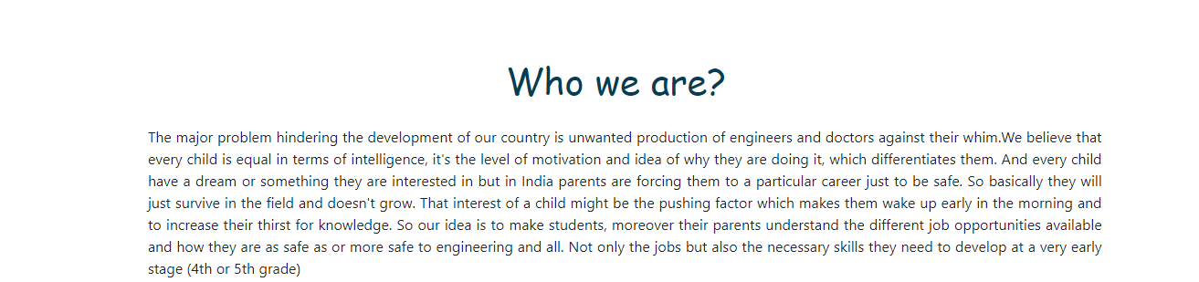

various attributes -
model

Slide 13

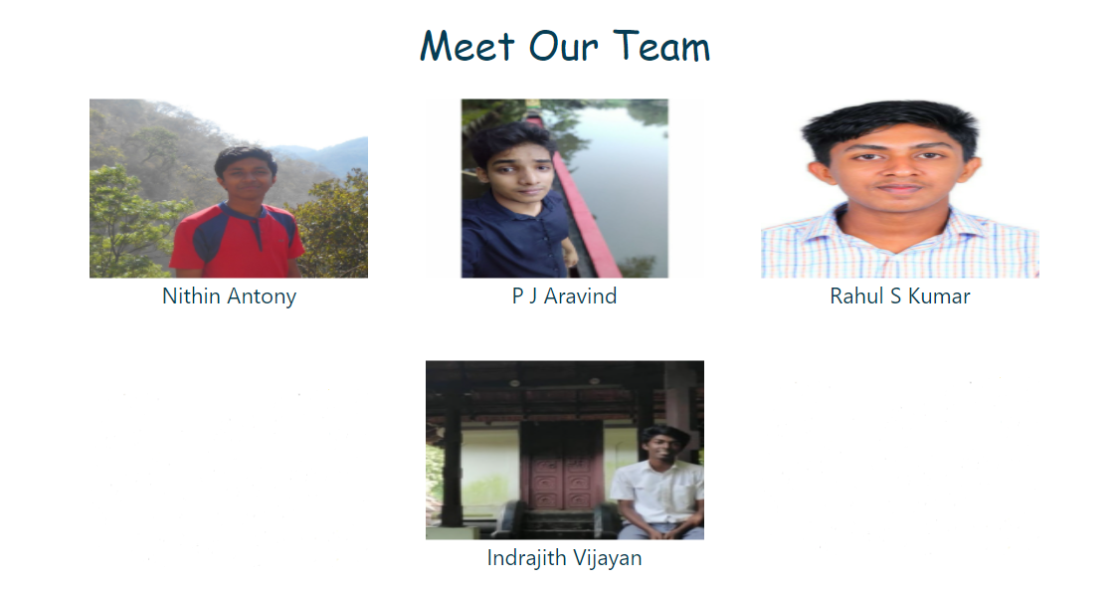

model

Slide 14
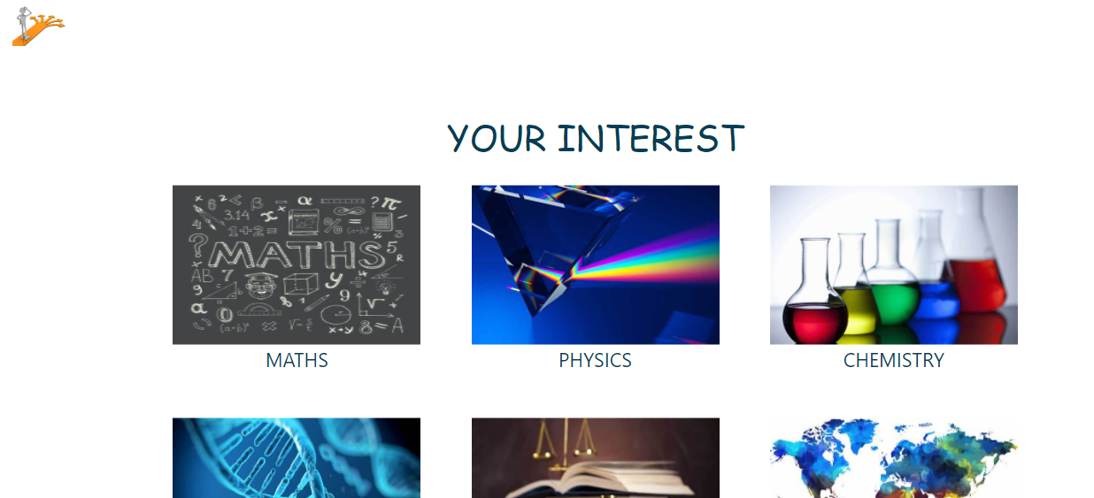
The guidance tab -
The most important tab in our website,it features as many topics as we could gather
Students can select their interested topic
model

Slide 15

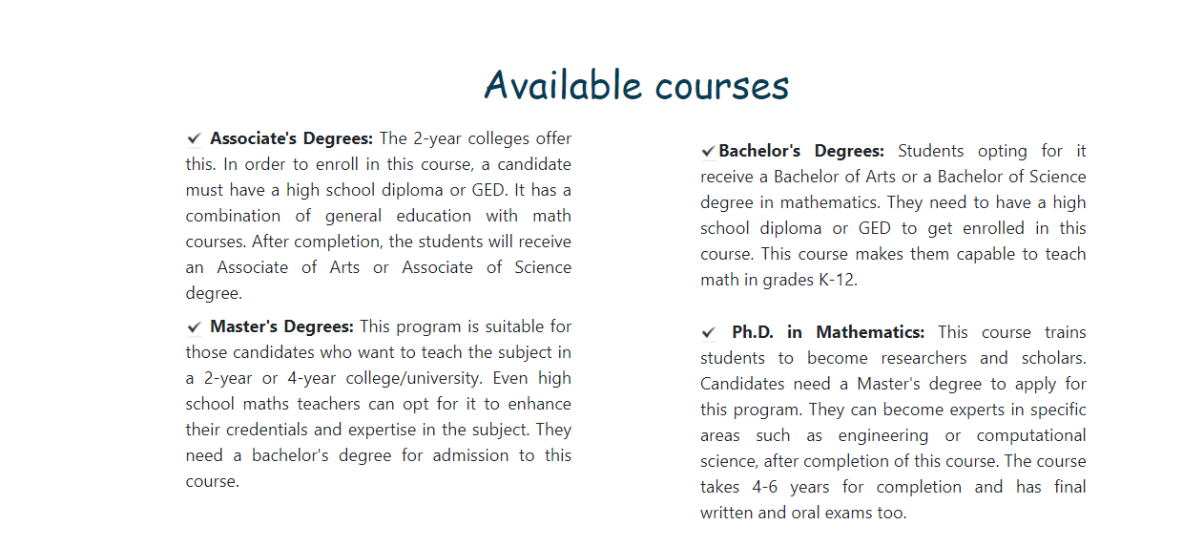
Then all job oppurtunities of that topic pops up,from which students can obtain info on necessary skills and a write up on successful personalities from that specific field.
model

Slide 16
ADDING NEW FEATURES ON THE GO………
model

